Slide 1
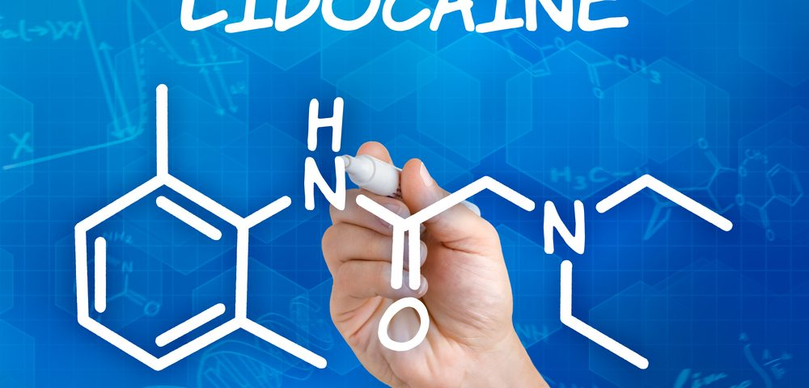
Perioperative Use of Intravenous Lidocaine
R2 ต่อพงศ์/อ.ธีรวัฒน์

Slide 2
Anesthesiology 4 2017, Vol.126, 729-737

Slide 3
Introduction : IV lidocaine
IV lidocaine
Concern about opioid risks in the postoperative period
Non-opioid analgesic adjuncts is preferable
IV lidocaine can decrease postoperative pain and improve other outcomes
But that evidence supporting its use varies by surgical procedure

Slide 4
Introduction : IV lidocaine
Perioperative lidocaine infusion
Mechanisms of prolonged postoperative benefit
Reviewed of clinical literature for may and may not be clinically useful
Focus on attaining postoperative benefits than intraoperative indications

Slide 5
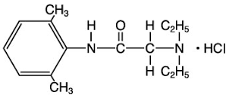
Pharmacology : IV Lidocaine
Amide-type local anesthetic
Elimination half-life : 90-120 min
Distribution: Lipophilic, widely distributed into body
Protein binding: 60-80 %
Metabolism: 90% metabolite in the liver, 10 % unchanged drug excreted by kidney
Metabolite : MEGX and GX

Slide 6
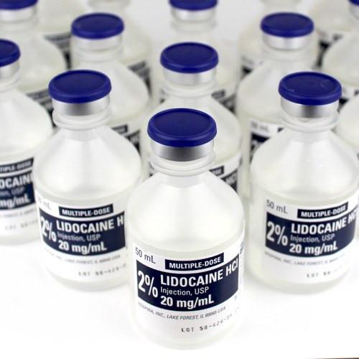
Pharmacology : IV Lidocaine
Time to steady state: 4–8 h (A continuous infusion without a bolus)
The context-sensitive half-time : 20–40 min (after 3 days infusion)

Slide 7
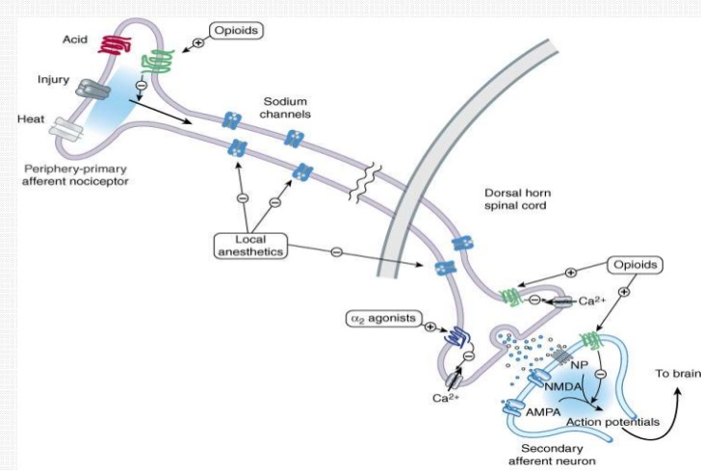
Pharmacology : IV Lidocaine
Mechanism of action : Classical action of lidocaine
Drug directly contact to the neural tissues
Block of sodium channels in neural tissues
Interrupting neuronal transmission

Slide 8
Pharmacology : IV Lidocaine
Mechanism of action : IV lidocaine
Significant analgesic, anti-hyperalgesic, and anti-inflammatory properties
Sodium channel blockade
Reduces sensitivity and activity of spinal cord neurons
Decreases NMDA post-synaptic depolarization

Slide 9
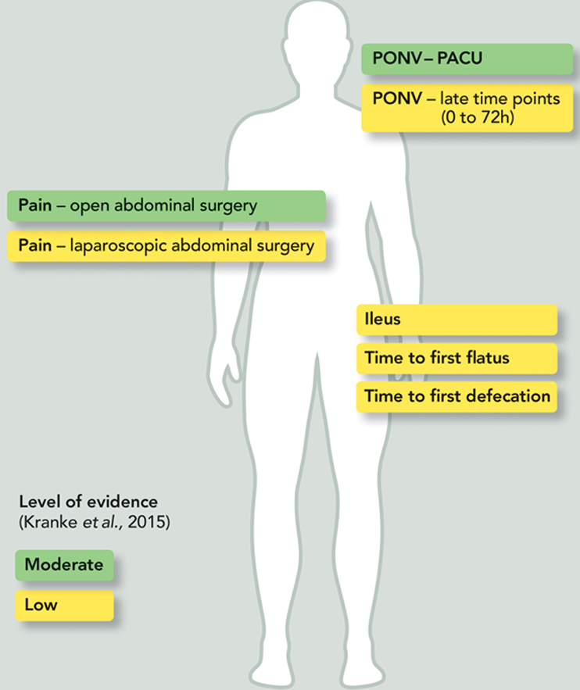
Pharmacology : IV Lidocaine
Benefits of perioperative lidocaine infusion
Reductions in
Pain
Nausea
Ileus
Opioid requirement
Length of hospital stay

Slide 10
Pharmacology : IV Lidocaine
Clinical benefit may be result from
Plasma lidocaine concentration
Prolong duration of clinical effect

Slide 11
Pharmacology : IV Lidocaine
Plasma lidocaine concentration
Mimic plasma concentration between IV & epidural
A reduction in opioid requirements might be a factor common to several of them
1-4 mcg/ml

Slide 12
Pharmacology : IV Lidocaine
Prolong duration of clinical effect
Effect of lidocaine exceeded the duration of the infusion by more than 8.5 h
This effect is an index used as a measure of preventive analgesia

Slide 13
Pharmacology : IV Lidocaine
How these benefits can occur?
At low blood concentrations during infusion
Persist for many hours or days after termination of the infusion

Slide 14
Pharmacology : IV Lidocaine
Preclinical studies have shown
Interactions between local anesthetics and the inflammatory system
The ability of local anesthetics to block priming of PMNs
Mechanism appears to be inhibition of a specific intracellular G-protein signaling molecule

Slide 15
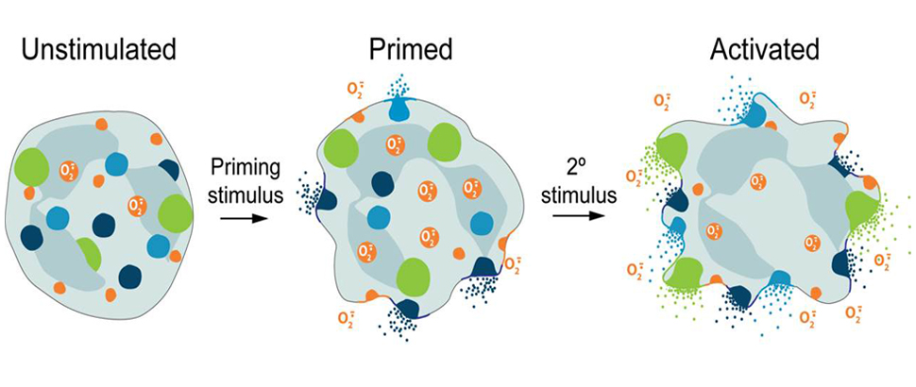
Pharmacology : IV Lidocaine
Release of
Cytokines
reactive oxygen species
Tissue injury
Damages the endothelium
Leads to vascular and organ injury
LA blocks very low concentration (0.1 mcg/ml)

Slide 16
Pharmacology : IV Lidocaine
This mechanism would explain both
The low concentrations at which lidocaine is active
The prolonged duration of effect

Slide 17
Clinical Applications : Abdominal Surgery
The clinical benefits have been reviewed in several recent meta-analyses and systematic reviews
A majority of these trials are open and laparoscopic abdominal procedures

Slide 19
Clinical Applications : Abdominal Surgery
Perioperative lidocaine infusion
Doses : 1.5 to 3 mg/kg/hr (after bolus 0-1.5mg/kg)
Improved postoperative pain
Decrease in early and late opioid consumption
Shortens the duration of postoperative ileus
Decreases the incidence of PONV
Reduces the length of hospital stay

Slide 20
Clinical Applications : Abdominal Surgery
Improved postoperative pain
VAS were decreased at rest/activity 24 hrs after surgery
1.1 for laparoscopic abdominal procedures
0.7 for open abdominal

Slide 21
Clinical Applications : Abdominal Surgery
Decrease in early and late opioid consumption
Reduce Opioid requirements In PACU
4.2 mg MO equivalent
Reduce Cumulative opioid consumption in first 24 to 72 h by
3.3 mg MO equivalents for open abdominal surgery
7.4 mg MO equivalents for laparoscopic abdominal procedures

Slide 22
Clinical Applications : Abdominal Surgery
Decrease in early and late opioid consumption
Infusion rates : ≥2 mg/kg/hr
Administration time : perioperative with continue postop 8-24 hr
Total analgesic consumption was reduced up to 35%-85%

Slide 23
Clinical Applications : Abdominal Surgery
Decrease in early and late opioid consumption
In colorectal surgery : pain score & opioid consumption
Perioperative lidocaine infusion = epidural with LA
An older trial found
Thoracic epidural > lidocaine infusion > opioid-based analgesia
In the bariatric surgery
Reduced 24-h opioid consumption 10 mg MO equivalents

Slide 24
Clinical Applications : Abdominal Surgery
Perioperative lidocaine infusion
Decrease duration of post-op ileus by an average of 8 hr
Decreases the incidence of PONV by 10 to 20%
Reduces the length of hospital stay by an average of 8 to 24 h

Slide 25
Clinical Applications : Abdominal Surgery
Perioperative lidocaine infusion
May have value for open and laparoscopic abdominal procedures
May be useful for enhanced recovery
May be an effective alternative for neuraxial analgesia

Slide 26
Clinical Applications : Genitourinary Surgery
Radical retropubic & laparoscopic prostatectomy
Decreased post-op pain scores by 2/3
Reduced opioid consumption in the PACU by 50%
First flatus occurred 33% earlier
Length of hospital stay was reduced by 1 day

Slide 27
Clinical Applications : OB&GYNE Surgery
In TAH study : 2 trials
No difference in length of hospital stay, pain scores, opioid consumption, PONV
These studies do not support the use of perioperative lidocaine infusion

Slide 28
Clinical Applications : OB&GYNE Surgery
In elective C/S under GA
Minimal increases in HR,BP & lower maternal plasma cortisol concentrations
No difference in neonatal Apgar score or acid–base status
May be reduce maternal stress response but no clear outcome benefits
Not support to routine use in OB surgery

Slide 29
Clinical Applications : Breast Surgery
No benefit in short term benefit
Morphine consumption & pain scores,
Duration of hospital stay, PONV, return of bowel function
Patient satisfaction
May be benefit in long-term effects
Reduced chronic postsurgical pain at 3 & 6 months

Slide 30
Clinical Applications : Ambulatory Surgery
Reduced pain scores and PACU opioid requirements
No difference in incidence of PONV or time to discharge
In ambulatory laparoscopic surgery
Discharged 26 min faster
Required less opioid medication after discharge

Slide 31
Clinical Applications : Ambulatory Surgery
May be benefit for patients undergoing ambulatory surgery procedures
Reduce opioid requirements
facilitate recovery and discharge

Slide 32
Clinical Applications : Cardiothoracic Surgery
In cardiac surgery
No difference in post-op pain or opioid, BZD consumption after CABG
Limitation is that lidocaine was not added to the CPB pump

Slide 33
Clinical Applications : Cardiothoracic Surgery
In cardiac surgery
Higher doses of lidocaine reduced the incidence of POCD after cardiac surgery
1.5 mg/kg bolus with 4 mg/min infusion & 4 mg/kg added to CPB priming
The available evidence does not support the use of perioperative lidocaine infusion for cardiac surgery patients

Slide 34
Clinical Applications : Cardiothoracic Surgery
In thoracic surgery
One study shows reduced pain scores and opioid consumption in the PACU and up to 6 h after surgery.
Lidocaine may have value for patients undergoing thoracic surgery who are not candidates for neuraxial analgesia

Slide 35
Clinical Applications : Hip Surgery
In total hip arthroplasty
No difference in pain scores or morphine consumption
No difference in functional outcomes, including pressure pain threshold, area of hyperalgesia or maximum degree of hip flexion
Suggests that the use of perioperative lidocaine infusion for hip surgery may not improve outcomes

Slide 36
Clinical Applications : Spine Surgery
In major spine surgery
Reduce pain scores with no difference in opioid consumption
Improved quality of life at 1 & 3 month after surgery
May provide benefit for patients undergoing major spine surgery

Slide 37
Practical application : Surgical procedures
Clinical effectiveness & Benefit
Open or laparoscopic abdominal surgery
Open or laparoscopic prostatectomy
May be benefit
Ambulatory surgery
Thoracic surgery & major spine surgery
Breast surgery

Slide 39
Practical application : Surgical procedures
May not be benefit or limited of data
OB & GYNE surgery
Cardiac surgery
Hip surgery

Slide 41
Practical application : Patient selection
Patients who may benefit
Alternative to regional analgesia
Enhanced recovery protocols
Opioid-sparing technique—obese, OSA, elderly, and those with opioid side-effects
Chronic pain & Neuropathic pain

Slide 42
Practical application : Patient selection
High-risk patients
Heart diseases : Heart block, heart failure, arrhythmia
Seizure disorder
Hepatic and renal dysfunction
Regional or plexus block is contraindication for IV lidocaine

Slide 43
Practical application : Lidocaine Toxicity
Toxic level of Lidocaine
Plasma level > 5 mcg/ml
At doses used in the studies, plasma concentrations remain < 5 mcg/ml even after 24 h infusion
Toxicity from perioperative lidocaine infusion is exceedingly rare
Only drowsiness is report in small number

Slide 44
Practical application : Lidocaine Toxicity
Monitoring plasma lidocaine levels may be considered in patients at increased risk for lidocaine toxicity
Abnormal liver or kidney function

Slide 45
Practical application : Lidocaine Toxicity

Slide 46
Practical application : Protocol
Adapted from University of Virginia Enhanced Recovery After Surgery Protocol for Colorectal Surgery

Slide 47
Conclusion : perioperative lidocaine
I.V. lidocaine is
Anti-inflammatory, anti-hyperalgesic, and gastrointestinal pro-peristaltic drug
Clinical effectiveness
Decreased pain scores, opioid analgesic consumption, and side-effects
Enhanced recovery after surgery outcomes

Slide 48
Conclusion : perioperative lidocaine
Benefit varies by surgical procedures
Abdominal surgery is highly evidence of benefit
May alternative to regional analgesia
Low adverse side effect and toxicity

Slide 49
Thank you for your attention

